Slide 1
Benchmarking & Performance Measurements (BPM)
Current WG Hot Topics/Main Issues
  draft-ietf-ippm-stamp-ext-hdr related work, draft-ietf-bpm-stamp-mpls-hdr, draft-ietf-spring-stamp-srpm-mpls and draft-ietf-spring-stamp-srpm-srv6 from MPLS and SPRING, presented at BPM IETF 127 to encourage more cross review.
  Alternate Marking YANG and IPFIX data modelling in BPM and OPSAWG. Coordinated WGLC.
  Good amount of proposed work on performance measurement, benchmarking, some IOAM and agent related. 6 documents in RFC editor, 1 at IESG, 2 in WGLC and 6 documents in adoption queue.
  NET4AI RG cooperation.
Admin Changes Since IETF#126
  Chartering concluded. BPM established since October 29th. Paint still wet.
  Leadership Update: Marcus Ihlar, Giuseppe Fioccola and Thomas Graf appointed as chair, Sarah Banks as Tech Advisor.
Main Achievements Since IETF#126
  draft-ietf-ippm-qoo, draft-ietf-ippm-stamp-ext-hdr, draft-ietf-ippm-ioam-data-integrity, draft-ietf-ippm-ioam-integrity-yang, draft-ietf-bmwg-network-tester-cfg and draft-ietf-bmwg-sr-bench-meth in RFC Ed Queue
  draft-ietf-bpm-alt-mark-deployment submitted to IESG.
  draft-ietf-ippm-alt-mark-yang concluded the WGLC.
  draft-ietf-ippm-encrypted-pdmv2 addressed reviews from SECDIR, INTDIR and TSVART and now ready for second WGLC.
  draft-ietf-bpm-stamp-mpls-hdr and draft-ietf-bpm-stamp-ber has been successfully adopted.
  draft-yl-bpm-cats working group adoption call ongoing.
  Perfmetrdir Updates Since IETF#126
  draft-ietf-cats-metric-definition and draft-ietf-ippm-stamp-ext-hdr reviewed. draft-ietf-mpls-mna-ioam review in progress.

Slide 2
BPM Chartering Recap
IPPM and BMWG joint Sessions have been experimented since IETF#123
  IETF#123, IETF#123, IPPM&BMWG Joint Interim, IETF#125, IETF#126
IPPM and BMWG joint charter has been first incubated in IETF#125 and publicly discussed on both ML and converged in IETF#126
The working group proposed to include a statement that documents in general require implementations and in certain circumstances exceptions can be applied, however during IESG review this has been pushed back as being ambiguous. Chairs decided to include in chairs slides instead.
The new WG (BPM) has been finally created in October 29, 2026 after IETF#126
  As the successor of IETF BMWG and IPPM WGs
  Thanks to everyone for the great contribution and inputs to BPM charter consolidation and constructive inputs through this process

Slide 3
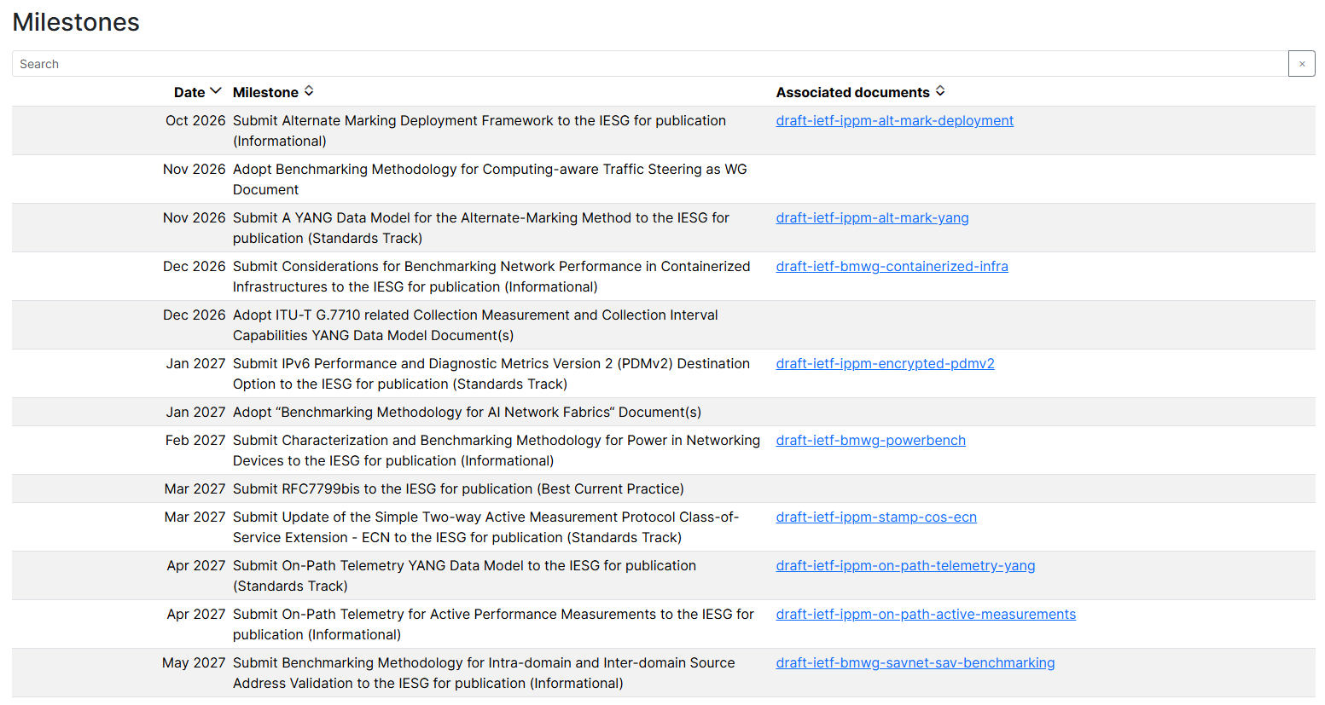
BPM Charter and Milestones
The BPM WG develops and maintains metrics, methodologies, and protocols that can be applied to the quality, performance, reliability, and scalability of data delivery services and applications running over public or private networks using IETF technologies.
These metrics, methodologies, and protocols
  can be used in production or independent testing groups in lab environments
  cover data, control, and management planes
  apply to hardware, virtualized, and containerized network infrastructure (including Network Management software systems and endpoints)
  are applicable to the IP and upper-layer protocols (work involving Layer 2 and MPLS data planes is in scope when it applies IETF-generic BPM mechanisms to these technologies)
The BPM WG maintains generic performance measurement protocols and their extensions, while collaborating with the other WGs that only work on performance-related procedures specific for their respective technology.
https://datatracker.ietf.org/wg/bpm/about/

Slide 4
BPM Working Transition Status
Transition Tasks | Time Frame | Status
BPM Creation | 2026-10-29 | Done
Send LSes to ITU-T, IEEE, 3GPP, BBF, and ETSI about BPM (Liaison Statements - Posted ) | 2026-11-05 | Done
Move IPPM and BMWG Subscribers to BPM | 2026-10-29 | Done
Close IPPM and BMWG Mailing list | 2026-11-04 | Done
Redirect email from IPPM and BMWG to BPM ML | 2026-11 | Done
Update BPM ML to point to IPPM and BMWG Archive https://mailman3.ietf.org/mailman3/lists/bpm@ietf.org/ | 2026-11 | Done
Update Datatracker pointing to IPPM/BMWG archives https://datatracker.ietf.org/wg/bpm/about/ | 2026-11 | Done
Move WG drafts, Published RFCs and New proposed I-Ds to BPM datatracker: https://datatracker.ietf.org/wg/bpm/documents/ | 2026-11 | Done
Close IPPM/BMWG WGs and add a note that BPM is the successor | 2026-11-04 | Done

Slide 5
BPM Working Transition Status
Transition Tasks | Time Frame | Status
Inform IPPM and BMWG draft authors to resubmit and rename the WG drafts and proposed I-Ds: Pending draft-ietf-ippm-* and draft-ietf-bmwg-* are reassigned to BPM | 2026-10-30 ~ | Work in Progress
Track Documents & Implementations in BPM Github Organization |  | Work in Progress
How to make good use of WG Session Time |  | Work in Progress
Coordinate with other WGs within IETF |  | Work in Progress

Slide 6
How to Make Good Use of WG Session Time?
Some concerns raised during BMWG and IPPM joint charter discussion
  Less focus, Less time for existing work items and new work
  Slow down progress of existing work or individual drafts
Some proposals for WG Chairs to consider:
  Reach out to authors to request status and plan meeting agenda early
  Allocate time based on mailing list and implementation activities
  Request 2 sessions during IETF week
    Each with 2 hour time length
    One session with 2 hour time length and the other with 1 hour time length
  Request Interim meetings for a dedicated topic requiring more discussions
  Encourage design team meeting between IETFs

Slide 7
How to Coordinate with Other IETF WGs
Plan Deep Dive on Benchmarking and Performance Measurement Tutorial
  Increase awareness as a whole and call for contributions
Joint Session with other relevant WGs for Common interests Topics
  E.g., BPM and CCAMP joint session on PM streaming
Encourage more coordination between IRTF and IETF
  MAPRG and BPM coordination
  NET4AI RG and BPM coordination

Slide 8
Track Documents & Implementations
Renamed github organization to https://github.com/ietf-bpm-wg
Update github organization with
  Measurement tools and protocol implementations
  Benchmarking Implementations
  Hackathon project outcome
  Testbed and Test set resources

